Slide 1


PASSWORD PROTECTION USING SGX
Intel Unnati Industrial Training Program
2024
TEAM : TECH BIRDS
TEAM LEADER: SRIDATRI SEN
TEAM MEMBER 2 : ROMIT KUMAR PAL
TEAM MEMBER 3 : SHIVAM SINGH

Slide 2

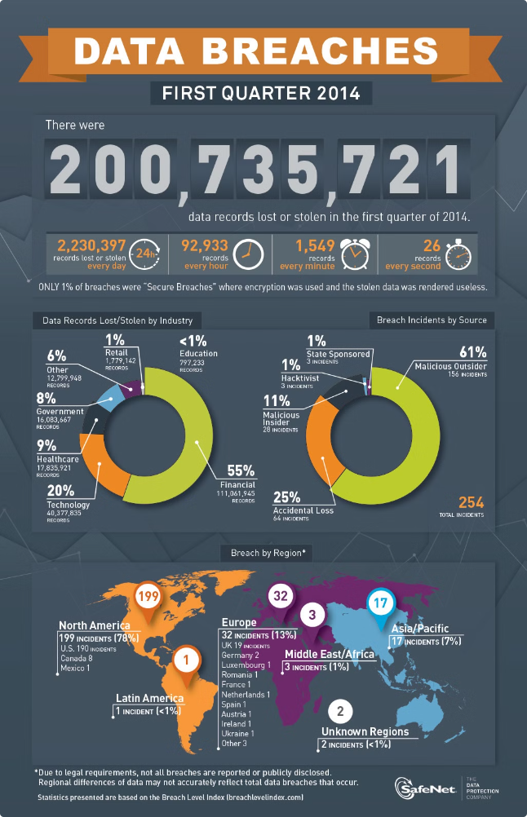
Problem Statement
TDX Full Disk Encryption
SGX Password Hashing
Protecting sensitive data on disk partitions from unauthorized access, preventing data breaches and loss of crucial information.
Ensuring the security of password hashing against database compromises, mitigating the risks of unauthorized access and identity theft.

Slide 3
Unique Idea
TDX Full Disk Encryption
SGX Password Hashing
Implement full disk encryption using Intel® Trust Domain Extensions (TDX), ensuring automatic encryption to prevent unauthorized data access.
Implement PBKDF2 password hashing within an Intel SGX enclave, providing secure password hashing that is resilient against GPU attacks and database compromises.

Slide 4

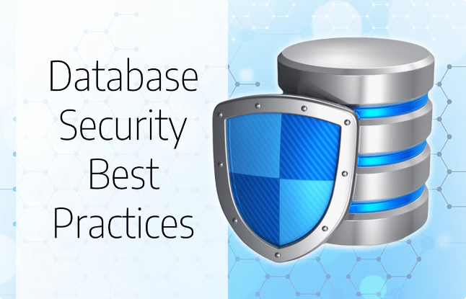
Features Offered
1
TDX Full Disk Encryption
2
SGX Password Hashing
Secure PBKDF2 hashing within SGX enclaves, data sealing with device-specific keys, and region-based access control for password hashes.
Automatic full disk encryption, key management through Key Broker Service (KBS), and secure decryption using fde-agent.

Slide 5

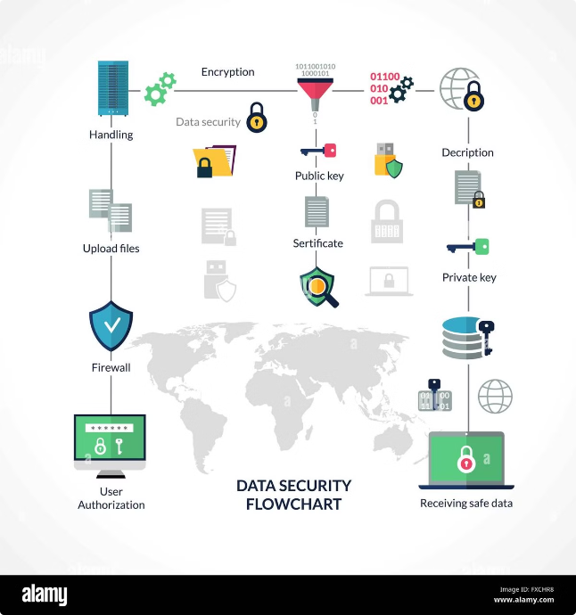
Process Flow
1
TDX Full Disk Encryption
Register Key, Build fde-agent, Create FDE Image, Enroll Variables, Launch TDVM.
2
SGX Password Hashing
Initialize Enclave, Hash Password, Seal Data, Store Hash.

Slide 6
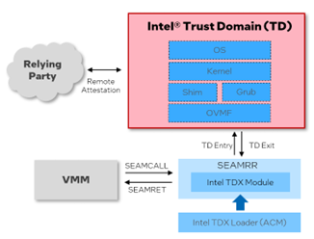
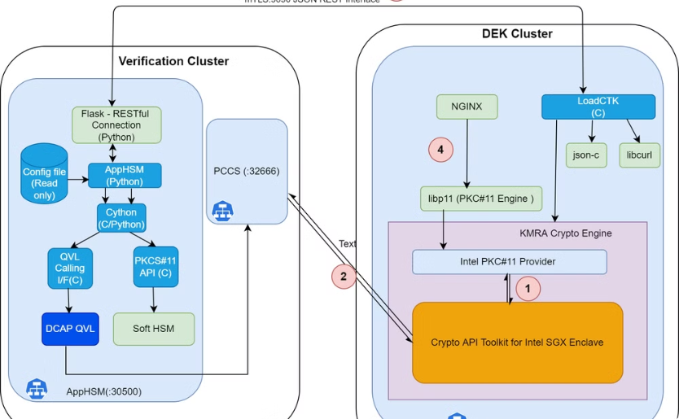

Architecture Diagram
TDX Full Disk Encryption
SGX Password Hashing
Key Broker Service (KBS), fde-agent, OVMF, and encrypted guest image.
SGX enclave, PBKDF2 hashing, data sealing, and region-based access.

Slide 7






Technology Used
Intel® Technologies
Ubuntu 22.04
Trust Domain Extensions (TDX) and Software Guard Extensions (SGX).
The operating system used for the implementation.
PBKDF2 Hashing
Intel SGX SDK
The algorithm used for secure password hashing.
The platform software and development kit used for SGX implementation.

Slide 8





Team members and contribution
Team Leader:
Sridatri Sen.
Role: Specialized in the development and
implementation of the SGX technology
and was responsible for creating secure
enclaves writing the necessary code to
protect sensitive information,
and ensuring that the data
within these enclaves was
securely processed and stored.
Team Member 2:
Romit Kumar Pal
Role: Focused on the overall project coordination and integration of SGX (Software Guard Extensions) and TDX (Trust Domain Extensions) into the password protection system. You ensured that the project's objectives were met, managed timelines, and facilitated effective communication among team members.
Team member 3:
Shivam Singh
Role: Worked on the TDX aspect of the project, focusing on enhancing the security of virtualized environments. They integrated TDX features to protect virtual machines, ensuring that the password protection system could operate securely in a virtualized infrastructure, thus providing an additional layer of security.

Slide 9





Conclusion
TDX Full Disk Encryption
Provides robust security for data at rest through full disk encryption, ensuring data is only accessible by authorized entities.
SGX Password Hashing
Enhances password security by leveraging SGX enclaves, protecting password hashes from being compromised, even if the database is breached.
Overall
These solutions leverage Intel technologies to enhance data security, ensuring sensitive information remains protected against unauthorized access and attacks.

